Slide 1
1
Dato
Titel
Notes:
1

Slide 2
Social Data Analysis
Group 55
Dato
Titel
2

Slide 3
The idea behind the project
The project investigates the relationship between air quality, specifically PM2.5 pollution levels, and asthma cases in New York City between 2009 and 2022.
To carry out this analysis, the following datasets are necessary:
  Air quality data: Historical PM2.5 levels in NYC.
  Health data: Asthma-related emergency department visits or hospitalizations data.
This analysis is interesting because it connects environmental data with health outcomes. Asthma is a major chronic condition influenced by environmental triggers, and identifying high-risk areas could guide interventions. The project may reveal whether marginalized communities are disproportionately affected by pollution. By analysing the historical data, we can understand whether the actions taken by the government at the time had a real impact on reducing the number of asthma cases.
Dato
Titel
3

Slide 4
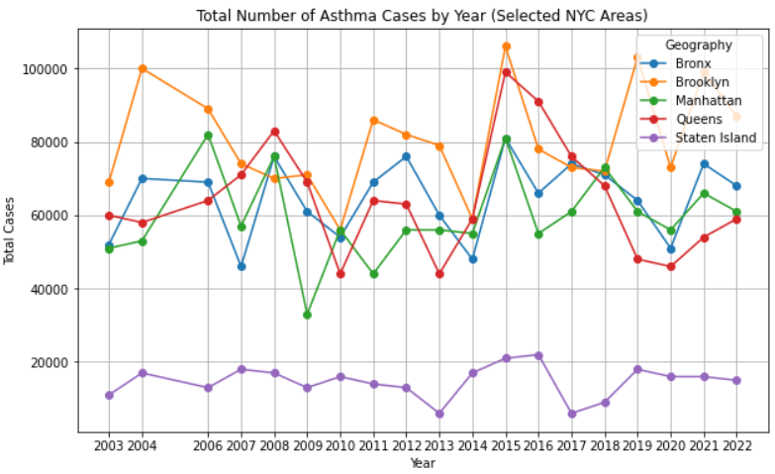
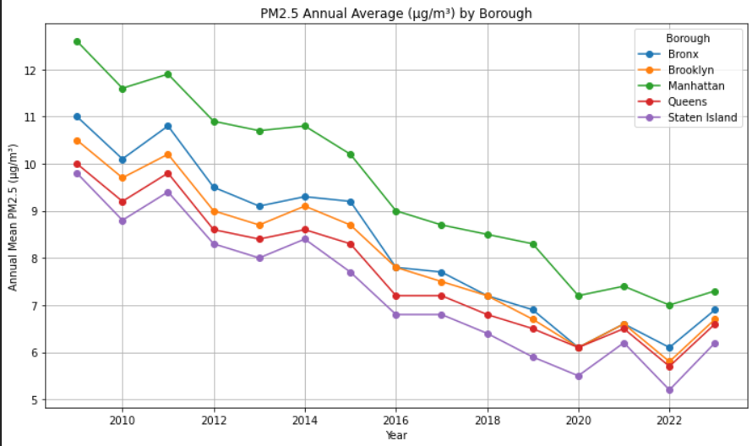
Preliminary data analysis
This project aims to use two datasets from the NYC Government, it combines annual air pollution data from 2009 to 2023 with public health data on asthma cases from 2003 to 2022. The asthma dataset contains 760 records across 8 variables, showing the number and percentage of cases aggregated by year and district. The PM2.5 dataset includes 1,863 records with annual, summer, and winter mean concentrations. Both datasets contain geographical information.
Dato
Titel
‹#›

Slide 5
The genre
What genre is it? (for Genres, see section 4.3 of the Segel and Heer paper)
Why is that genre right for telling the story you want to communicate with the data
Dato
Titel
‹#›

Slide 6
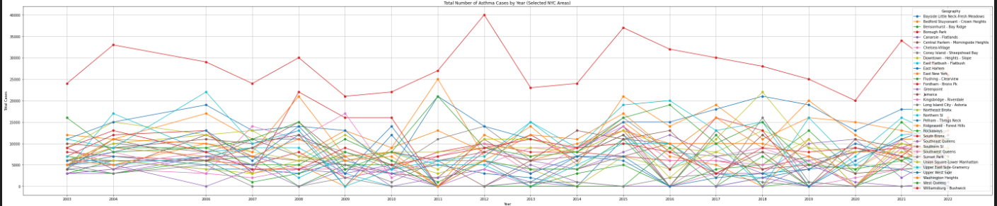
Visualizations
Dato
Titel
4

Slide 7
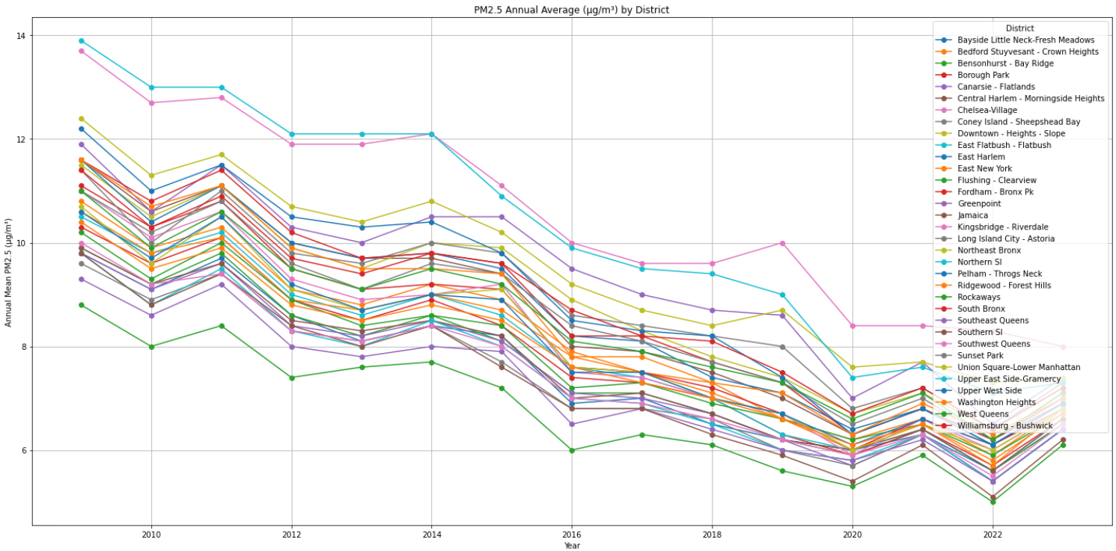
Visualizations
Dato
Titel
5

Slide 8
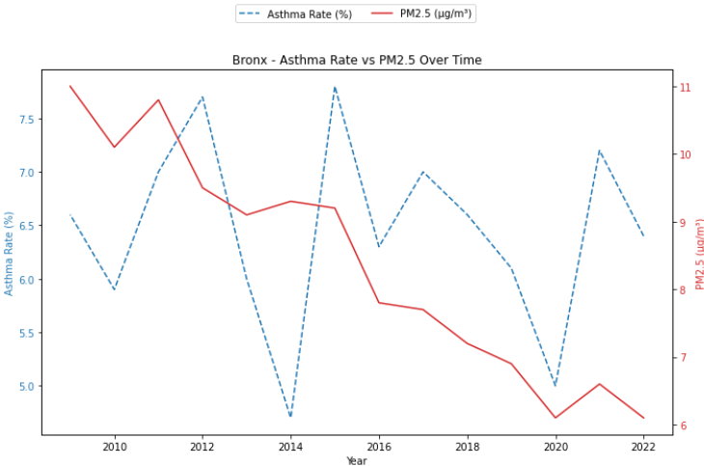
Visualizations
Dato
Titel
‹#›

Slide 9
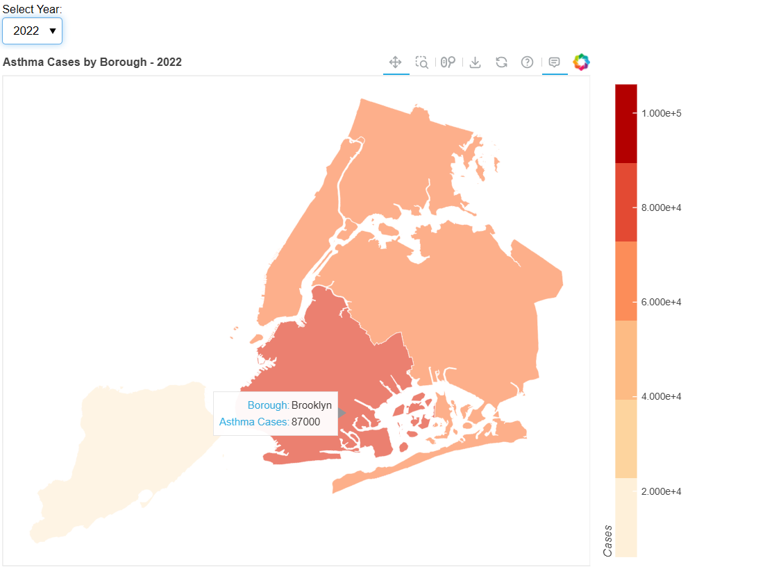
Visualizations
Dato
Titel
8

Slide 10
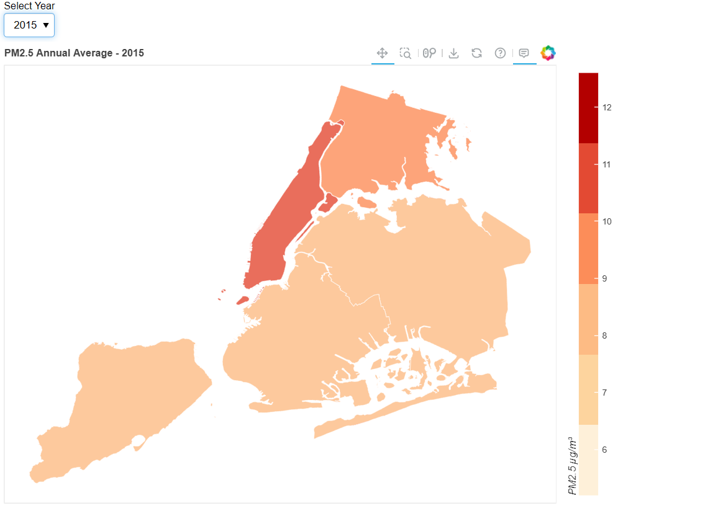
Visualizations
Dato
Titel
7

Slide 11
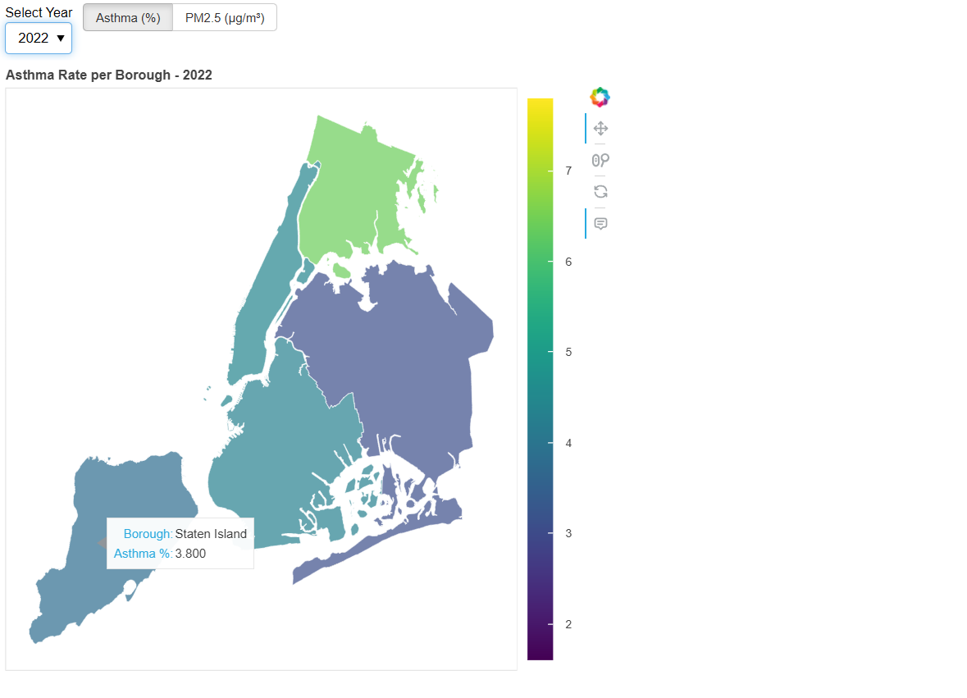
Visualizations
Dato
Titel
6

Slide 12
Dato
Titel
‹#›

